Slide 1

Tabletop Torsion Device
Design Review I
By: Brendan Keane, Logan M^{c}Call, Reggie Scott, Mark Swain
Instructor: Dr. Nikhil Gupta
Sponsor: Mr. Philip Flater (Munitions Directorate Eglin AFB) Advisor: Dr. Simone Hruda

Slide 2
Overview
Background with Constraints
DIC
Design Overview
  Current Status of Components
Budget
Plan of Action
Conclusion
Brendan Keane

Slide 3
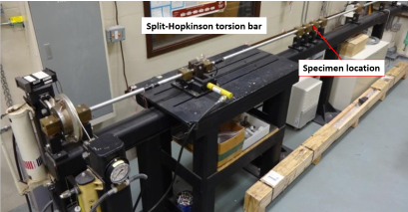
Background with Constraints
Existing test hardware at Eglin AFB is not well-suited for characterizing relatively-small test samples that have been fabricated from plate or bar stock
Maximum torque output: 100Nm
Machine must fit in an area (footprint) of 1m²
Monotonic(one direction)
free-end torsion loading
  If possible add cyclic
Axial 1 DoF
Compatible with DIC
Budget - $2,000
Figure 2.1: Existing Torsion Machine
Brendan Keane
Notes:
The reason for limited plate thickness is not a matter of cost, however it is a matter of geometry. When the Munitions Directorate is fabricating components of the munitions they use raw stock that is as close to final shape as possible to conserve waste material. In order to properly characterize the materials that end up in a product they have to simply test similar geometry in order the get accurate results.

Slide 4
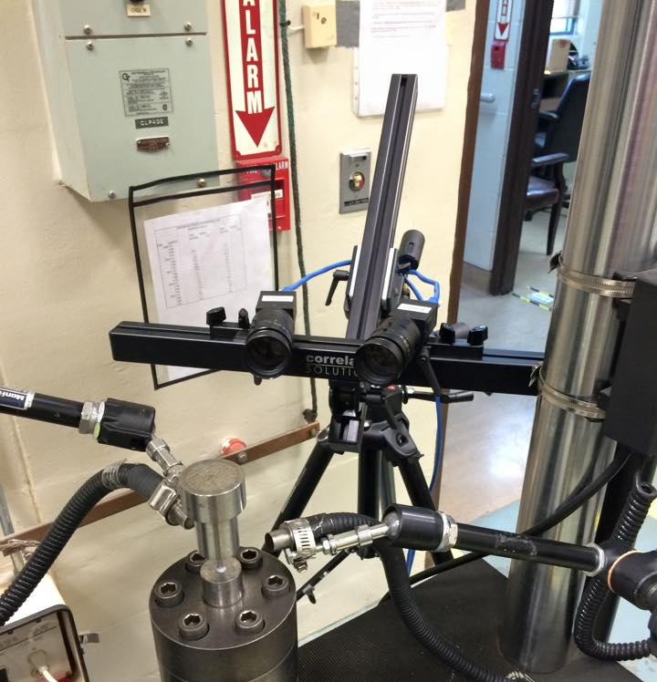
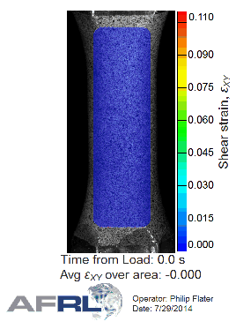
DIC (Digital Image Correlation)
Figure 3.1 DIC setup at Eglin AFRL
Figure 3.2 Example DIC use in torsion sample
“DISTRIBUTION A: Approved for public release, distribution unlimited. (96ABW-2014-1649)”
Brendan Keane

Slide 5

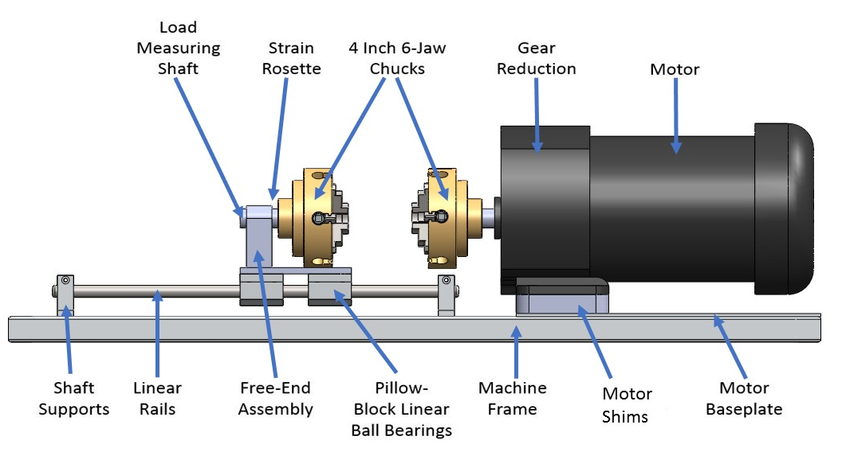
Design Overview
Steel Shaft
Figure 5.1: CAD representation of design
Brendan Keane

Slide 6
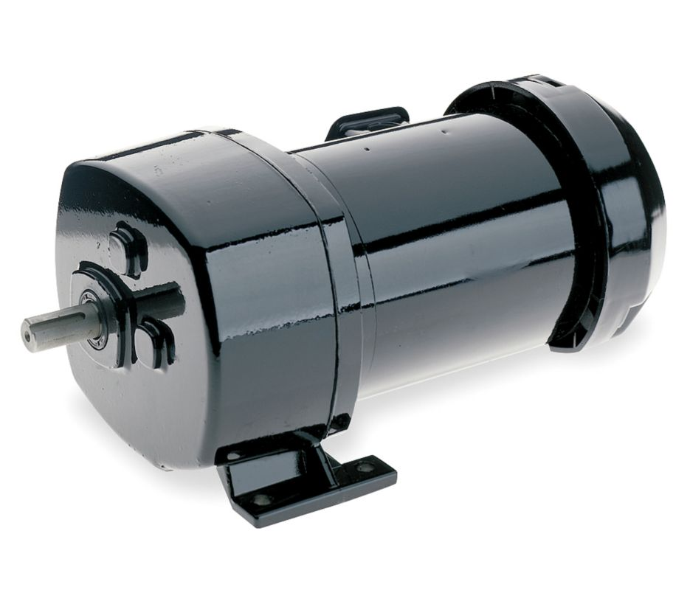
Load Generation: AC Gearmotor
Vendor: Grainger
Rpm: 18
Input HP: 1/3
Gear ratio: 95:1
Max torque: 116 Nm
Weight: 26 lbs
Figure 5.1: AC Gearmotor
Brendan Keane

Slide 7
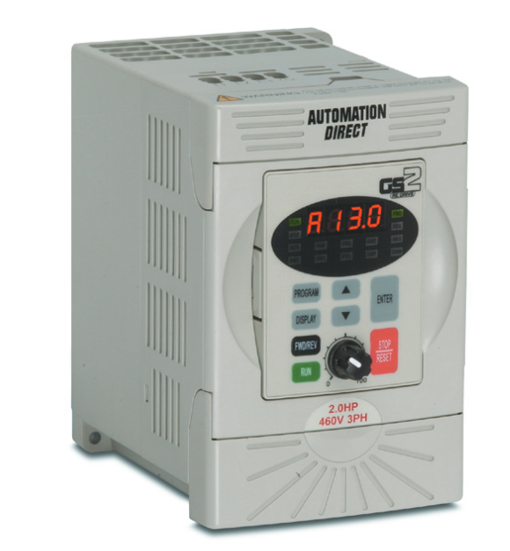
Motor Control
Variable Frequency Drive (VFD)
Vendor: Automation Direct
Single phase input, three phase output
Digital keypad
Forward and reverse
Expandable
Figure 6.1: Variable frequency drive
Brendan Keane

Slide 8
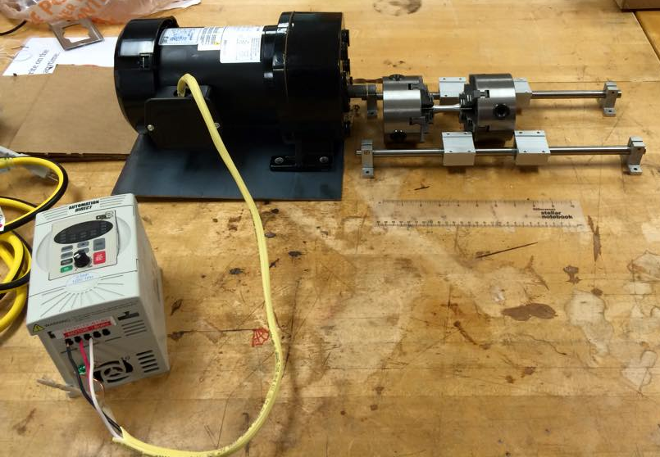
Motor Testing
Testing the interface between motor and VFD
Currently capabilities
  Forward and reverse motion by button press
  RPM/Torque control
Desired capabilities
  Automated cyclic loading
  Set specific shaft rotation
Figure 7.1: Testing of motor and VFD capabilities
Brendan Keane

Slide 9
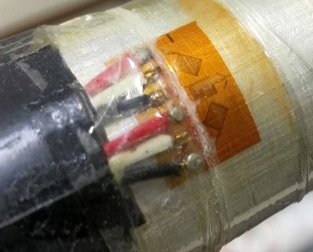
Load Measurement
Measuring components provided by AFRL
  DIC
  Strain gauges
Coupler material: Al 6061
Shaft properties
  Shear modulus: 26 GPa
  Shear strength: 76 MPa
  Length: 7.6 cm
  Diameter: 1.9 cm
  Expected shear stress for
    Al 2024: 29.5 MPa
    Titanium: 5325435325234MPa
Figure 8.1: Strain rosette setup
Brendan Keane

Slide 10
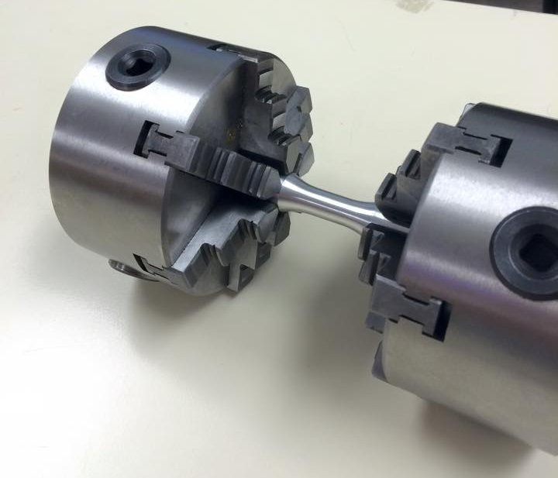
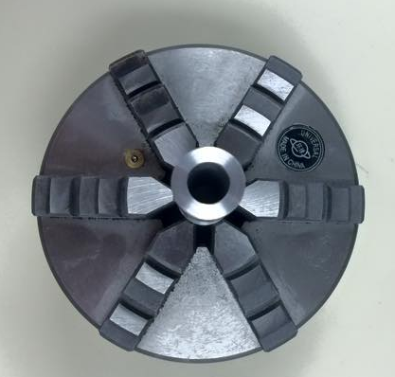
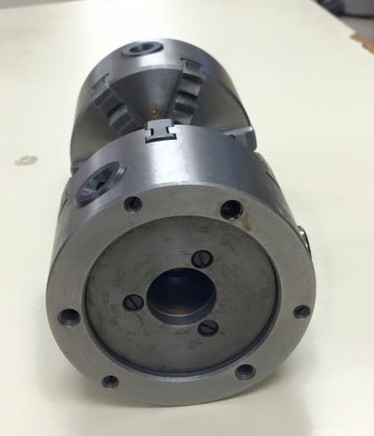
Load Application: 6-Jaw Chuck
Vendor: LittleMachineShop
Weight: 6.4 lbs
Outer diameter: 3.94 in
Inner diameter: 1.02 in
Figure 9.1: 6 Jaw Chucks holding specimen
Logan McCall

Slide 11
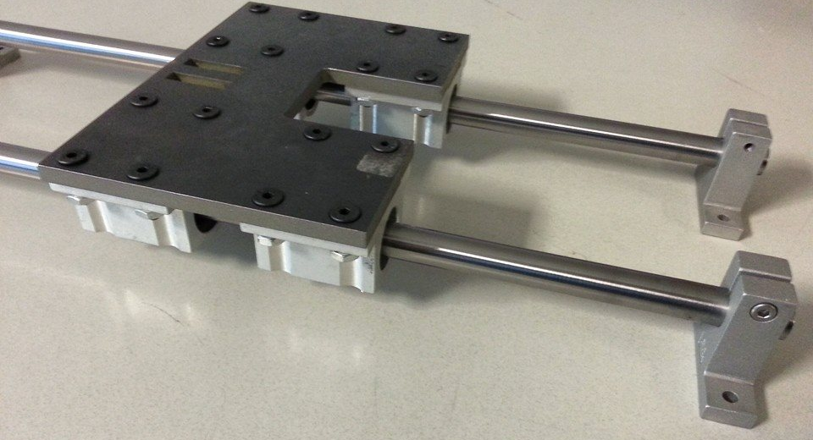
Linear Motion: 2 Rail Ball Bearing Guide
Vendor: Grainger
Rail Diameter: ½ in
Material: Steel
Deflection < 0.001 in
Figure 10.1: Linear motion components
Logan McCall

Slide 12
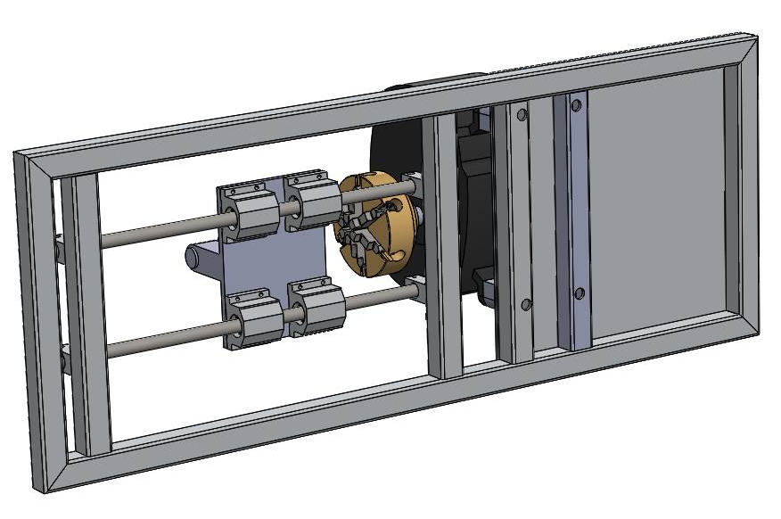
Housing Design
Steel frame and housing
Shape: hollow square shaped cross-section
Frame dimensions:
  1/8 in inner supports – 304 stainless steel
  1/8 in outer frame - low carbon 1015 steel
Figure 11.1: CAD drawing of frame (bottom view)
Logan McCall

Slide 13
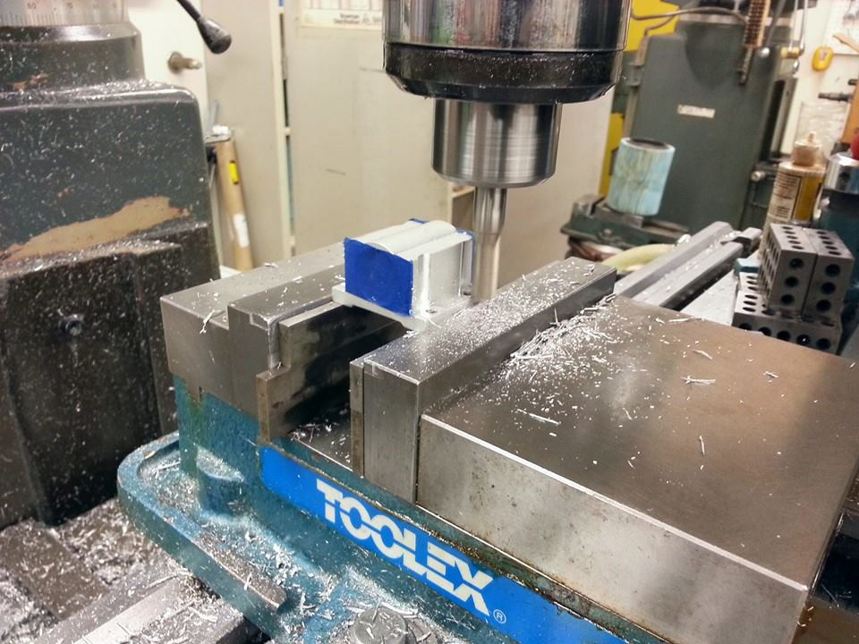
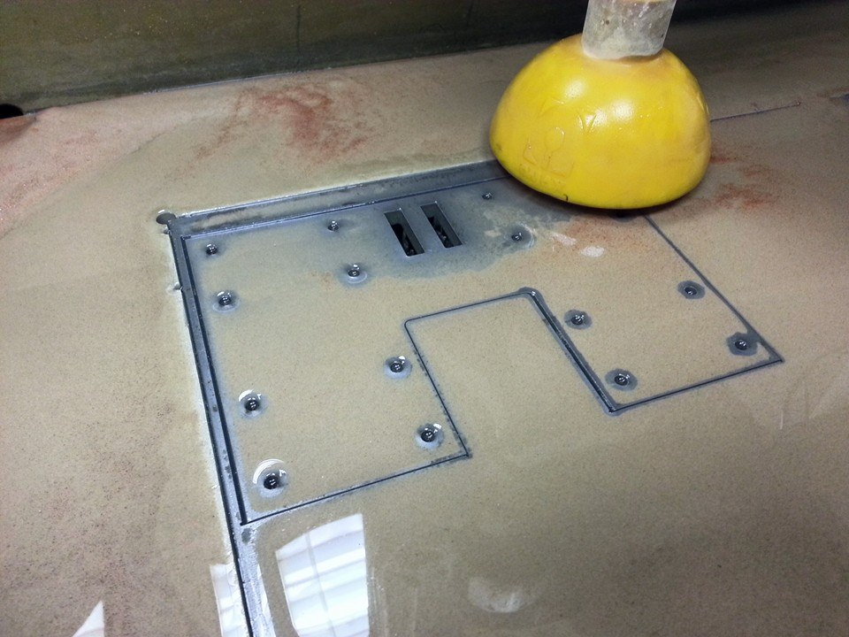
Machining Progress
Figure 12.1: Mill used to create space for nuts
Figure 12.2: Baseplate of free end
Logan McCall

Slide 14
Challenges
Budget
Motor Control
  Learning how to use a VFD
  Cyclic loading
Assembly Issues
  Choosing right materials
  Difficulties in machining/assembling
Logan McCall

Slide 15
Budget
Budget: $2,000
Spent: $1,839
Net: + $161
Logan McCall

Slide 16
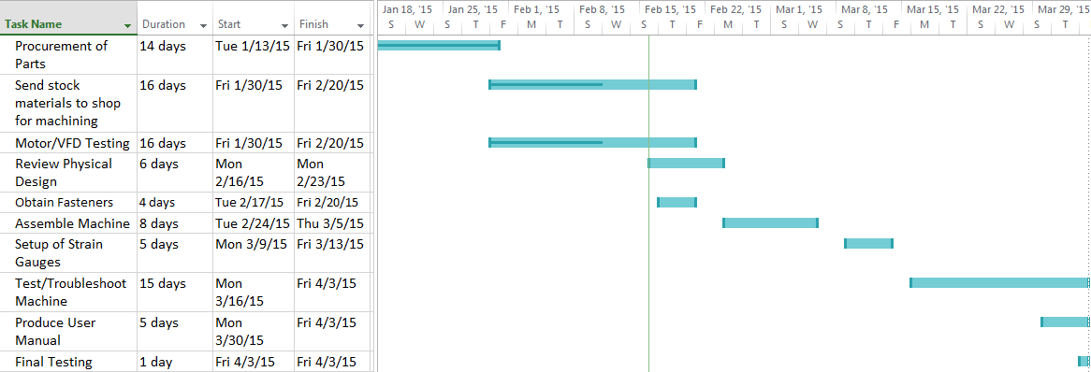
Plan of Action
Logan McCall

Slide 17
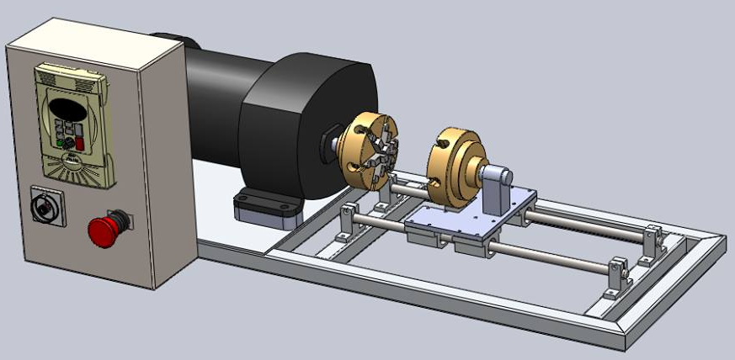
Conclusion
Goal Statement
  Design a more effective way of testing small specimens in free-end torsion.
Next Phase
  Finalize Machining
  Fasteners
  Assembly and testing
Figure 16.1: Design slated for production
Logan McCall
Notes:
Completion of initial design sketches- Preliminary calculations- Design selection for full CAD build- Full CAD build

Slide 18
Questions?

Slide 19
References
Carter, B. (2008). Texas Instruments: Op Amp Noise Theory and Applications. Retrieved September 22, 2014
Flater, P. (2014). Tabletop Torsion Test. Eglin, FL: Air Force Research Laboratory.
Ilic, M. (2014, October 11). Clamp for centering. Retrieved from GRABCAD: https://grabcad.com/library/stega-za-centriranje-clamp-for-centering-1
Lathe Chuck. (2014, October 7). Retrieved from GRABCAD: https://grabcad.com/library/lathe-chuck-3
Linear Motion Systems. (2014, September 28). Retrieved from Stock Drive Products: https://sdp-si.com/eStore/coverpg/linearmotion.htm
http://www.centuryspring.com/info/spring_measurement.php - spring picture
Mark Swain

Slide 20
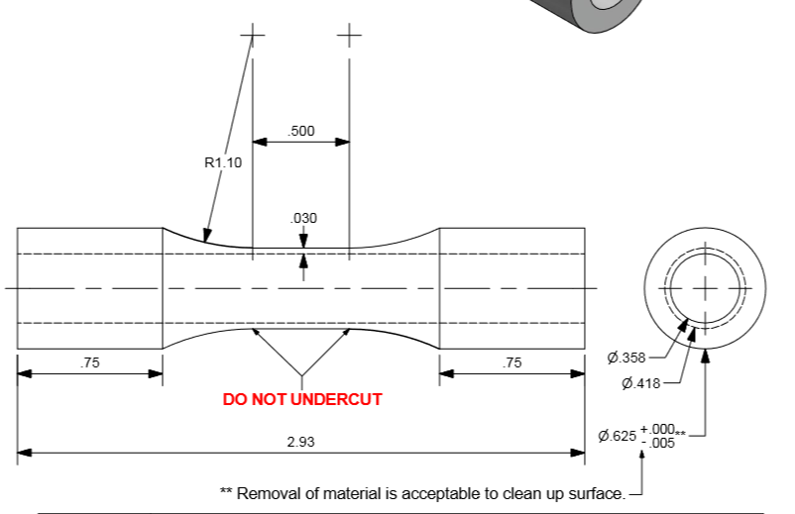
Specimen Dimensions
Brendan Keane

